Slide 1
Dallas Cloud Native Meetup
Empowering Developers:
Tackling Security and Risk in Cloud Native Environments
Chris Davis, CISSP Jun 2024

Slide 2
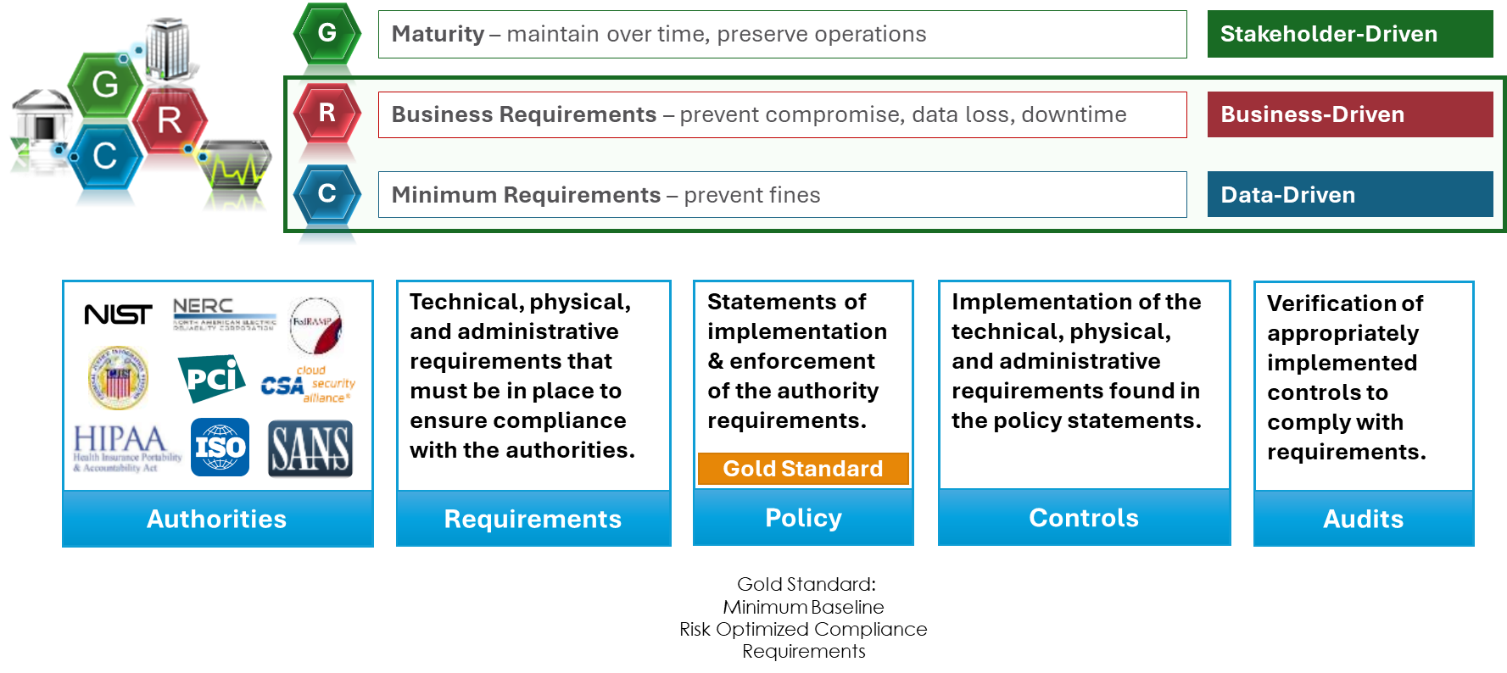
Review the Business Context. Understand the “Why?”

Slide 3
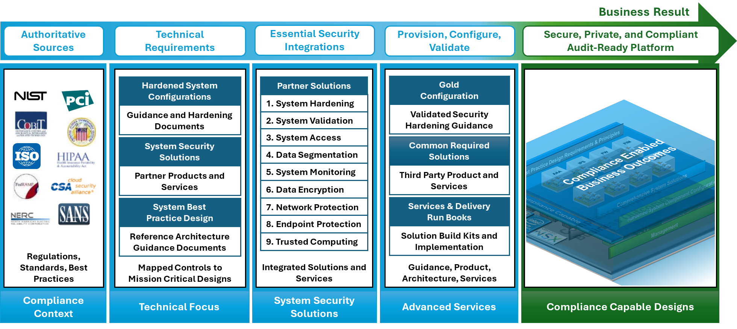
The Short Answer: How to build secure, private, and resilient systems.

Slide 4
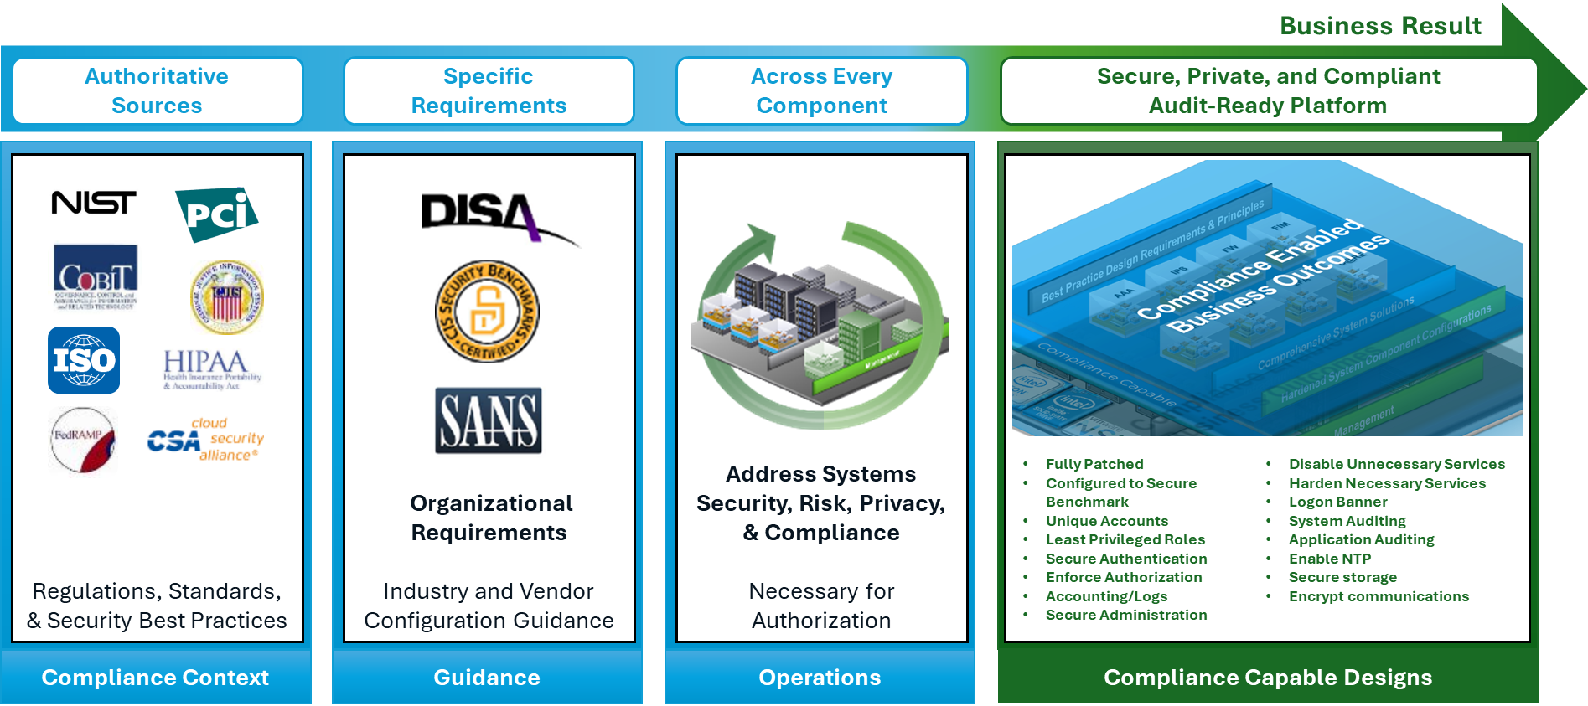
Step 1: Configurations
Hardened System Configurations

Slide 5
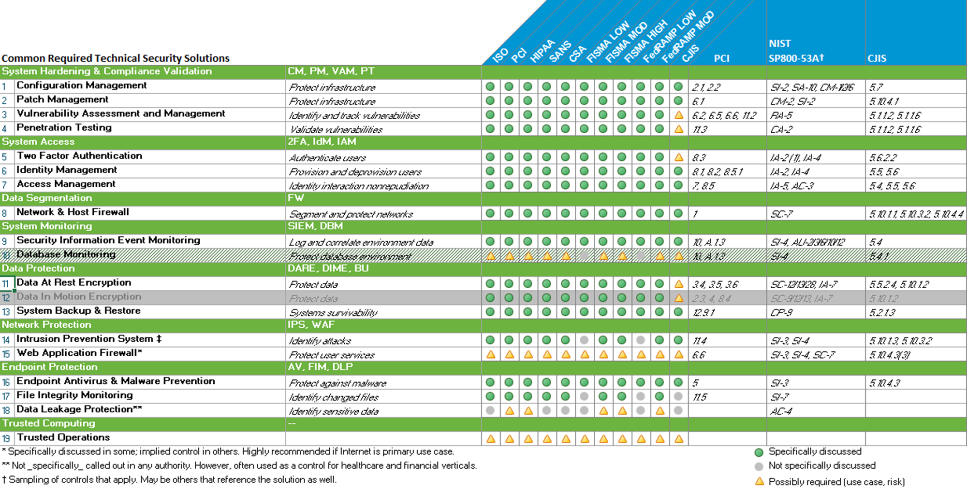
Step 2: Solutions
System Security Solutions

Slide 6
Step 3: Design
System Design Best Practices
SECURITY DESIGN PRINCIPLES
Design Considerations
SECURITY DESIGN PRINCIPLES
Security Architecture and Design
Clear Abstraction | Hierarchical Trust
Least Common Mechanism | Inverse Modification Threshold
Modularity and Layering | Hierarchical Protection
Partially Ordered Dependencies | Minimized Security Elements
Efficiently Mediated Access | Least Privilege
Minimized Sharing | Predicate Permission
Reduced Complexity | Self-Reliant Trustworthiness
Secure Evolvability | Secure Distributed Composition
Trusted Components | Trusted Communication Channels
Security Capability and Intrinsic Behaviors
Continuous Protection | Secure Failure and Recovery
Secure Metadata Management | Economic Security
Self-Analysis | Performance Security
Accountability and Traceability | Human Factored Security
Secure Defaults | Acceptable Security
Life Cycle Security
Repeatable and Documented Procedures | Secure System Modification
Procedural Rigor | Sufficient Documentation
Understand your scope
Scope is inclusive of workloads that store, process, or transmit protected data, inclusive of the physical and management infrastructure that directly support the workloads. There are few exceptions.
Build it properly
Components and systems architecturally designed correctly earlier in the SDL requires less rework and cost later.
Governance is key
Strong change controls help prevent inappropriate modification safeguards.
Separation of duties, least privilege, multifactor authentication, and appropriate logging are critical for administrative operations.
Applying configuration and design best practices across workloads in a mixed mode environment can lead to reduced risk and operational overhead.
Security and Privacy Engineering Principles SP 800-53r5 SA-08
Clear Abstractions | Trusted Communications Channels
Least Common Mechanism | Continuous Protection
Modularity and Layering | Secure Metadata Management
Partially Ordered Dependencies | Self-analysis
Efficiently Mediated Access | Accountability and Traceability
Minimized Sharing | Secure Defaults
Reduced Complexity | Secure Failure and Recovery
Secure Evolvability | Economic Security
Trusted Components | Performance Security
Hierarchical Trust | Human Factored Security
Inverse Modification Threshold | Acceptable Security
Hierarchical Protection | Repeatable and Documented
Minimized Security Elements | Procedural Rigor
Least Privilege | Secure System Modification
Predicate Permission | Sufficient Documentation
Self-reliant Trustworthiness | Minimization
Secure Distributed Composition
Source: Special Publication 800-160 Systems Security Engineering
Considerations for a Multidisciplinary Approach in the Engineering of Trustworthy Secure Systems

Slide 7
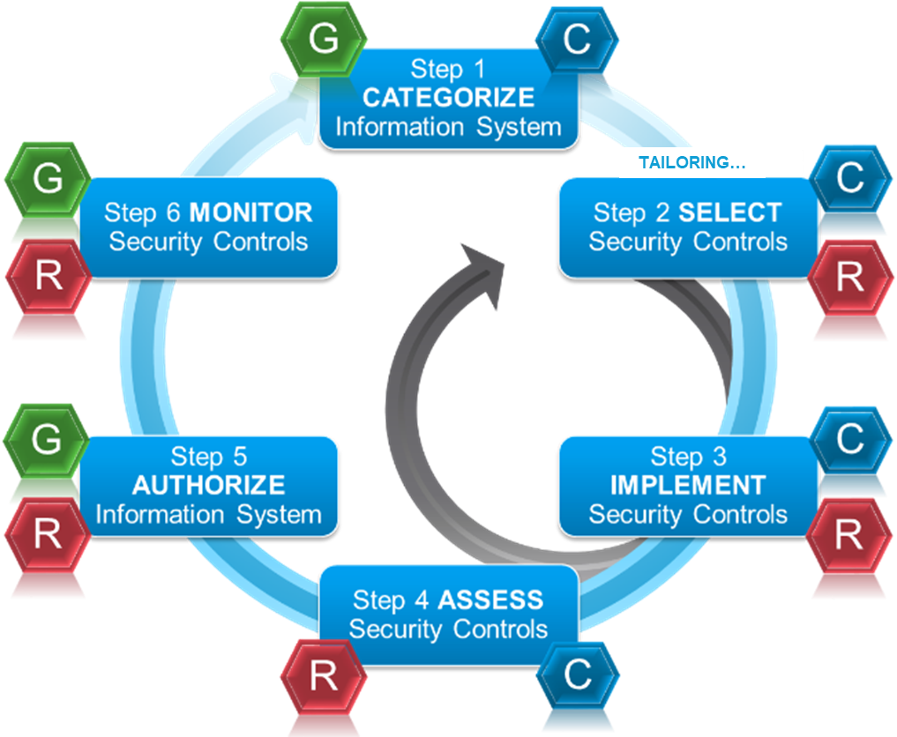
Managing Environment Hygiene. Continuous Risk Assessment. Governance. Risk Management Framework. Automate complexity.
FIGURE 2-2: RISK MANAGEMENT FRAMEWORK
NIST Special Publication 800-37
Guide for Applying the Risk Management Framework to Federal Information Systems
A Security Life Cycle Approach
Architecture Description
Architecture Reference Models;
Segment and Solution Architectures; Mission and Business Processes; Information System Boundaries
Organizational Inputs
Laws, Directives, Policy Guidance; Strategic Goals and Objectives; Priorities and Resource Availability;
Supply Chain Considerations

Slide 8
Build Your Developer Cybersecurity MVP for New Products (Example using NIST SP 800-53r5)
Auditing Controls
Include Required Audit Events
Include Required Audit Log Information
Actions on Audit Logging Process Failure
Enable Audit Log Offloading
Actions on Audit Logging Storage Capacity Warning
Require Privileged Access to Change Auditing
This example includes broad input coverage of these frameworks to meet common objectives. This is only an example.
NIST SP 800-53r5 FedRAMP High
NIST Privacy Framework
NIST SP 800-171r2 (CMMC)
ISO-IEC 27002
ISO IEC 27017
ISO IEC 27018
PCI DSSv4
Access Controls
Cryptographically Authenticate Identities and Protect Authenticators
Enforce Password Requirements
Limit Consecutive Invalid Logon Attempts
Implement Replay-Resistant Techniques for Authenticators
Encrypt Authentication Assertions When Passed Through Third Parties
Force Reauthentication
Enforce Authorized Logical Access
Uniquely Identify and Authenticate Users
Obscure Authentication Feedback
Uniquely Identify and Authenticate Devices
Enable Implementation of AAA Services
Enforce PKI Requirements
Prevent Unauthorized and Unintended Information Transfer
Prohibit Use of Shared Accounts
Prohibit Embedding Unencrypted Static Authenticators
Expire Cached Authenticators
Additional Storage Controls
Encrypt Information at Rest
Remove, mask, encrypt, hash, or replace Privacy Identifiers
Application Controls
Update Software and Firmware Components and Applications
Enable Logon Banner Display
Restrict System to Essential Capabilities
Validate Inputs
Implement Separate Execution Domains for Each Process
Protect Security Functionality
Provide Concise and Secure Error Messages
Enforce Cryptographic Validation for SW and FW Updates
Implement Memory Protection Measures
Ensure Fail-Safe Operations to Secure State
Enable System Clock Synchronization
Restrict Code Execution Privilege Levels
Restrict Software Library Modifications
Session Controls
Deny by Default and Explicitly Authorize All Other Network Traffic
Encrypt Transmitted Data
Encrypt Remote Sessions
Terminate Network Sessions Based on Specific Conditions
Limit Concurrent Sessions
Implement Logout Functionality
Validation and Testing: Hardware, Software, and Firmware
Manual Code Reviews, Static and Dynamic Code Analysis
Threat Modeling
Penetration Testing and Vulnerability Scans
Notes:
Different List:
Secure Boot: Implement Secure Boot to ensure that only trusted software can run during the boot process.
Firmware Security: Ensure that firmware is kept up to date and is protected against tampering. Consider using firmware integrity checking mechanisms.
Privacy Impact Assessment (PIA): Conduct PIAs to evaluate how the early version affects user privacy and ensure compliance with relevant privacy regulations.
Data Integrity Verification: Use checksums and cryptographic hashes to verify the integrity of critical data.
Application Whitelisting: Implement application whitelisting to allow only approved applications to run on the system.
Memory Protection Mechanisms: Use techniques such as Address Space Layout Randomization (ASLR) and Data Execution Prevention (DEP) to protect against memory-based attacks.
Zero Trust Architecture: Adopt a Zero Trust security model, ensuring that no user or system is trusted by default and that strict verification is required for all access requests.
Red Teaming and Blue Teaming: Conduct red teaming exercises to simulate attacks and test defenses, and use blue teaming to enhance defensive measures based on findings.
Network Segmentation: Segment the network to isolate critical systems and limit the spread of potential threats.
Fully Patched: Ensure all components of the early version, including the kernel and drivers, are up-to-date with the latest security patches.
Configured to Secure Benchmark: Configure systems according to industry-standard security benchmarks (e.g., CIS benchmarks) to ensure a hardened security posture. Unique Accounts: Use unique accounts for all users accessing the early version to prevent shared account usage and ensure accountability.
Least Privileged Roles: Apply the principle of least privilege to all accounts and roles, granting only the minimum permissions necessary for users to perform their tasks. Secure Authentication: Implement strong, multifactor authentication mechanisms to verify user identities.
Enforced Authority and Authorizations: Strictly enforce authorization policies to control access to sensitive functionalities and data. Use role-based access control (RBAC) to manage user permissions.
Strict Accounting/Logs: Enable comprehensive logging and monitoring to capture all user activities, system events, and security incidents. Implement strict accounting measures to track access and changes to critical systems and data.
Secured Administration: Use secure, dedicated channels for administrative tasks (e.g., SSH with key-based authentication). Restrict administrative access to trusted personnel and ensure administrative interfaces are well-protected.
Disable Unnecessary Services: Disable any services that are not required for the operation of the early version to minimize the attack surface.
Harden Necessary Services: Apply security best practices to harden services that are necessary, such as limiting network exposure and applying security configurations.
Logon Banner with Disclaimer: Implement a logon banner with a legal disclaimer to inform users about the nature of the early access and any associated risks.
Additional System Auditing: Conduct regular system audits to ensure compliance with security policies and to identify potential security issues. Perform vulnerability scanning and security assessments periodically.
Application Auditing: Audit applications running on the early version for security vulnerabilities and ensure they follow secure development practices.
Encrypted Storage: Use encryption to protect sensitive data stored on the system, including files and databases. Ensure encryption keys are securely managed.
Encrypted Communications: Implement encryption (e.g., TLS/SSL) for all network communications to protect data in transit. Use secure protocols for remote access and data exchange.
Backup and Recovery: Ensure regular backups are taken and securely stored. Develop and test disaster recovery plans to ensure data integrity and availability in case of an incident.
User Education and Training: Provide training and resources to users and developers about the security measures in place and their roles in maintaining security. Encourage prompt reporting of any security concerns or incidents.

Slide 9
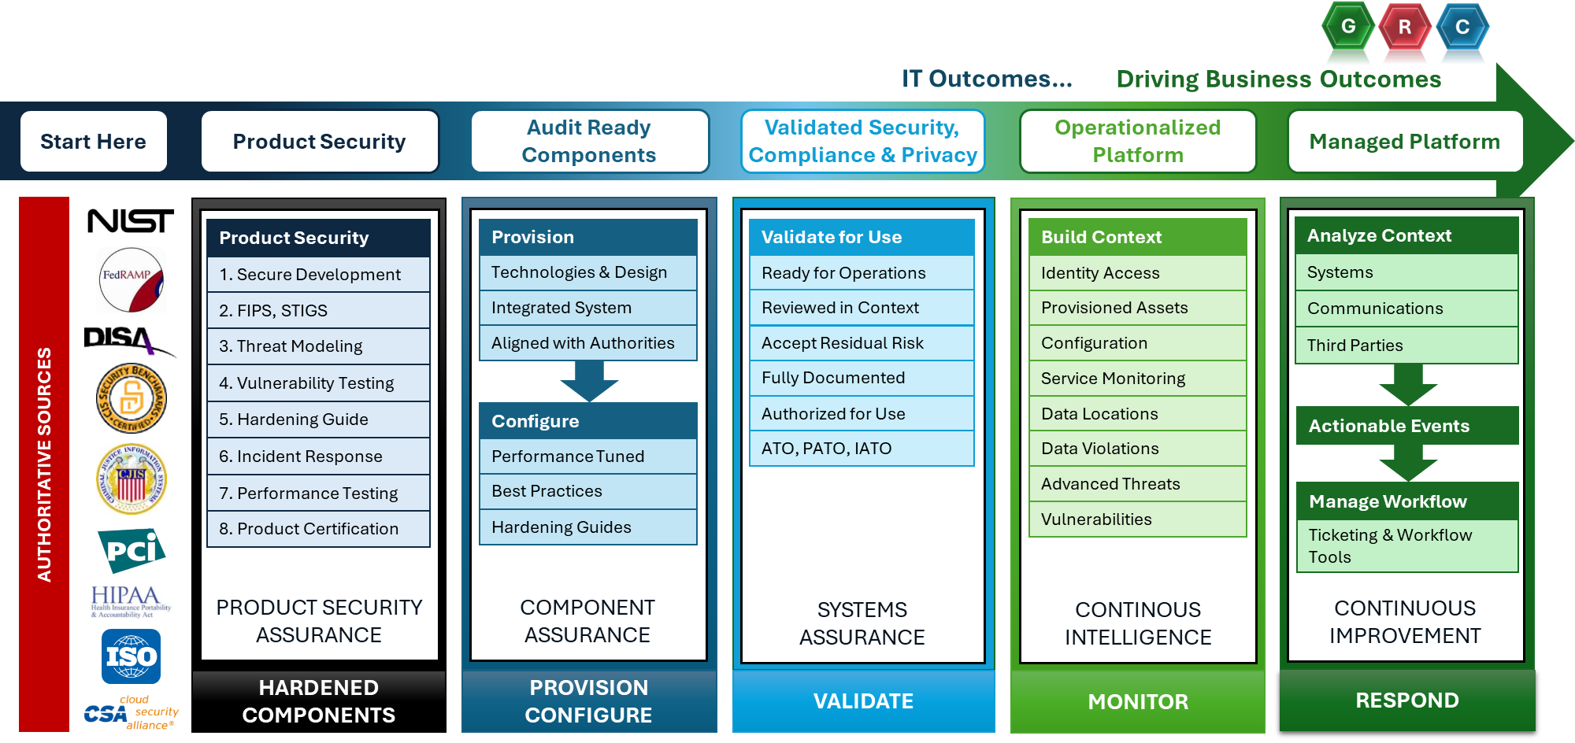
Result: Engineering Trusted Systems Putting Everything Together

Slide 10
So what? What can I do?
Action items…
Identify your Minimum Viable Product (MVP) requirements.
Know the difference between Product security and Systems security (Configuration vs. Solutions vs. Design)
Consider measuring your maturity on a scale.
Identify where each requirement is addressed.
Minimize duplicity.
Learn the concepts and reapply to new projects.
Review your training.
Document everything.
Everything should be as simple as possible, but not simpler. -- Albert Einstien

Slide 11
THANK YOU!

Slide 12
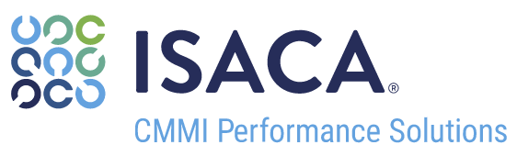

Cybersecurity Framework Maturity Scorecard Executive Summary
5
LEVEL
CHARACTERISTICS
MATURITY
LEVEL
5
OPTIMIZED
Stable and flexible.
Organization is focused on continuous improvement and resiliency. Added stability enables agility and innovation.
Protection standards are operationalized through automation and advanced technologies.
MATURITY
LEVEL
4
MANAGED
Measured and controlled.
Organization response to alerts are data-driven with quantitative performance objectives. Measurement drives improvement.
3
3
MATURITY
LEVEL
3
DEFINED
Proactive, rather than reactive.
Organization-wide risk management standards provide documented guidance for effective response, remediation, and posture validation.
Risks to IT assets are identified and managed in a standard, well defined process.
An IR plan defines steps for incident preparation, analysis, containment, eradication, and post incident.
2
MATURITY
LEVEL
2
REPEATABLE
Managed for each event.
Organization response to alerts are planned, performed, measured, and controlled in a repeatable manner.
Anomaly detection is established through detection tools and monitoring procedures.
1
MATURITY
LEVEL
1
INITIAL
Unpredictable and reactive.
Organization responds to alerts, but they are often delayed or completed with disjointed efforts.
The process for recovering from an incident is non-existent.
MATURITY
LEVEL
0
NON-
EXISTENT
Unaware or lacking resources.
Organization is unaware of risk or lacks the resources to effectively manage risk.
Cybersecurity Framework Functions
Identify
Protect
Detect
Respond
Recover

Slide 13
Cybersecurity Framework Maturity Scorecard Category Summary
LEVEL
CHARACTERISTICS
CSF FUNCTION |  | CSF CATEGORY | MATURITY LEVEL
Identify | ID.AM | Asset Management
 | ID.BE | Business Environment
 | ID.GV | Governance
 | ID.RA | Risk Assessment
 | ID.RM | Risk Management Strategy
 | ID.SC | Supply Chain Risk Management
Protect | PR.AC | Identity Management and Access Control
 | PR.AT | Awareness and Training
 | PR.DS | Data Security
 | PR.IP | Information Protection Processes and Procedures
 | PR.MA | Maintenance
 | PR.PT | Protective Technology
Detect | DE.AE | Anomalies and Events
 | DE.CM | Security Continuous Monitoring
 | DE.DP | Detection Processes
Respond | RS.RP | Response Planning
 | RS.CO | Communications
 | RS.AN | Analysis
 | RS.MI | Mitigation
 | RS.IM | Improvements
Recover | RC.RP | Recovery Planning
 | RC.IM | Improvements
 | RC.CO | Communications
MATURITY
LEVEL
5
OPTIMIZED
Stable and flexible.
Organization is focused on continuous improvement and resiliency. Added stability enables agility and innovation.
MATURITY
LEVEL
4
MANAGED
Measured and controlled.
Organization response to alerts are data-driven with quantitative performance objectives. Measurement drives improvement.
MATURITY
LEVEL
3
DEFINED
Proactive, rather than reactive.
Organization-wide risk management standards provide documented guidance for effective response, remediation, and posture validation.
MATURITY
LEVEL
2
REPEATABLE
Managed for each event.
Organization response to alerts are planned, performed, measured, and controlled in a repeatable manner.
MATURITY
LEVEL
1
INITIAL
Unpredictable and reactive.
Organization responds to alerts, but they are often delayed or completed with disjointed efforts.
MATURITY
LEVEL
0
NON-
EXISTENT
Unaware or lacking resources.
Organization is unaware of risk or lacks the resources to effectively manage events.

Slide 14
Cybersecurity Framework Maturity Discussion Deep Dive: Topic
LEVEL
CHARACTERISTICS
DISCUSSION
MATURITY
LEVEL
5
OPTIMIZED
Stable and flexible.
Organization is focused on continuous improvement and resiliency. Added stability enables agility and innovation.
Discussion text.
Prescriptive Analytics
Foresight
5
MATURITY
LEVEL
4
MANAGED
Measured and controlled.
Organization response to alerts are data-driven with quantitative performance objectives. Measurement drives improvement.
Discussion text.
Predictive Analytics
Insight
4
MATURITY
LEVEL
3
DEFINED
Proactive, rather than reactive.
Organization-wide risk management standards provide documented guidance for effective response, remediation, and posture validation.
Discussion text.
Strategic Analytics
Program focused
3
MATURITY
LEVEL
2
REPEATABLE
Managed for each event.
Organization response to alerts are planned, performed, measured, and controlled in a repeatable manner.
Discussion text.
Advanced Reporting
Hindsight
2
MATURITY
LEVEL
1
INITIAL
Unpredictable and reactive.
Organization responds to alerts, but they are often delayed or completed with disjointed efforts.
Discussion text.
Reactive Reporting
Issue focused
1
MATURITY
LEVEL
0
NON-
EXISTENT
Unaware or lacking resources.
Organization is unaware of risk or lacks the resources to effectively manage events.
Discussion text.
No Reporting
Struggling to get
basic information
0

Slide 15
Assessing Cybersecurity Maturity: Example
Utilizing the chart below, an organization can align its cybersecurity capabilities against each of the NIST CSF Functions to produce a representative maturity rating.
ISACA CMMI MATURITY LEVELS
1
Initial
2
Repeatable
3
Defined
4
Managed
5
Optimized
NIST CSF FUNCTIONS
Identify
Little to no cybersecurity risk identification.
Process for cybersecurity risk identification exists, but it is immature.
Risks to IT assets are identified and managed in a standard, well defined process.
Risks to the business environment are identified and proactively monitored on a periodic basis.
Cybersecurity risks are continuously monitored and incorporated into business decisions.
Protect
Asset protection is reactive and ad-hoc.
Data protection mechanisms are implemented across the environment.
Data is formally defined and protected in accordance with its classification.
The environment is proactively monitored via protective technologies.
Protection standards are operationalized through automation and advanced technologies.
Detect
Anomalies or events are not detected or not detected in a timely manner.
Anomaly detection is established through detection tools and monitoring procedures.
A baseline of "normal" activity is established and applied against tools/procedures to better identify malicious activity.
Continuous monitoring program is established to detect threats in real time.
Detection and monitoring solutions are continuously learning behaviors and adjusting detection capabilities.
Respond
The process for responding to incidents is reactive or non-existent.
Analysis capabilities are applied consistently to incidents by Incident Response (IR) roles.
An IR Plan defines steps for incident preparation, analysis, containment, eradication, and post incident.
Response times and impacts of incidents are monitored and minimized.
The capabilities of all IT personnel, procedures, technologies are regularly tested and updated.
Recover
The process for recovering from incidents is reactive or non-existent.
Resiliency and recovery capabilities are applied consistently to incidents impacting business operations.
A Continuity & Disaster Recovery Plan defines steps to continue critical functions and recover to normal operations.
Recovery times and impacts of incidents are monitored and minimized.
The capabilities of all IT personnel, procedures, technologies are regularly tested and updated.

Slide 16
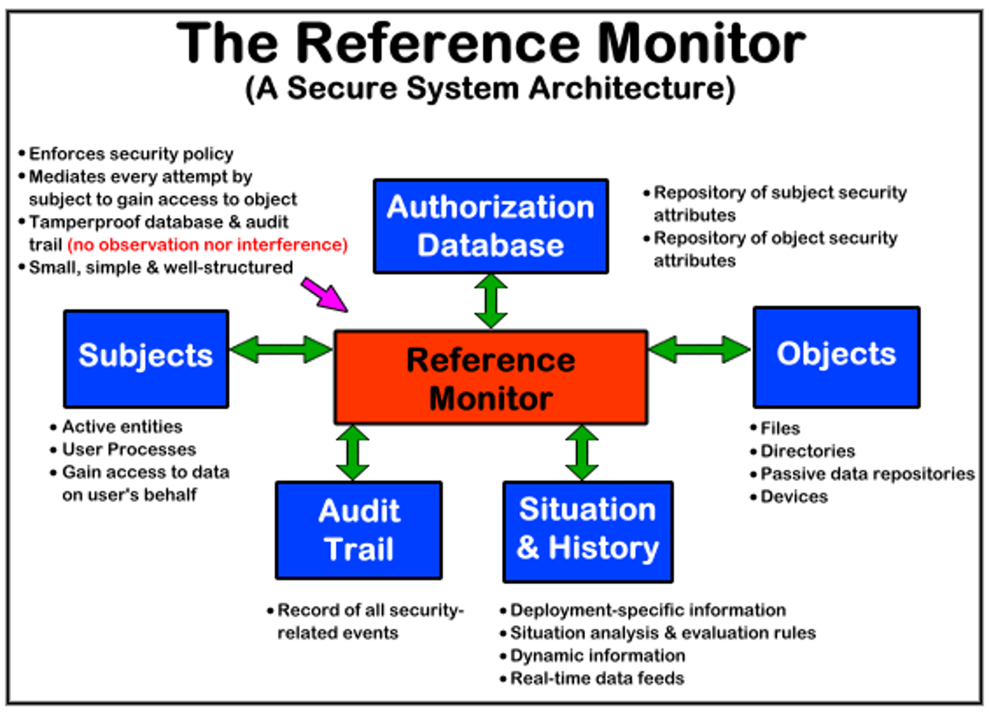
The Reference Monitor Concept from 1972
Trusted Computer System Evaluation Criteria
https://fas.org/irp/nsa/rainbow/std001.htm
DoD 5200.28-STD
DEPARTMENT OF DEFENSE STANDARD
6.1 THE REFERENCE MONITOR CONCEPT
In October of 1972, the Computer Security Technology Planning Study, conducted by James P. Anderson & Co., produced a report for the Electronic Systems Division (ESD) of the United States Air Force.[1] In that report, the concept of "a reference monitor which enforces the authorized access relationships between subjects and objects of a system" was introduced. The reference monitor concept was found to be an essential element of any system that would provide multilevel secure computing facilities and controls.

